Slide 1
REMEDY GENIE
Adam Doyle
HDS-5230
Fine-tuning LLMs for Safe Home Remedies with Unsloth Framework
Harika Pamulapati
Nandini Yadav Gudala
Kavya Reddy Gondhi
Sangameshwar Ryakala
Murali Krishna Enugula

Slide 2

Introduction
This project focuses on fine-tuning Large Language Models (LLMs) using the Unsloth framework to create a specialized AI assistant that offers natural home remedies for common non-serious illnesses.

Slide 3
01
Project Overview

Slide 4
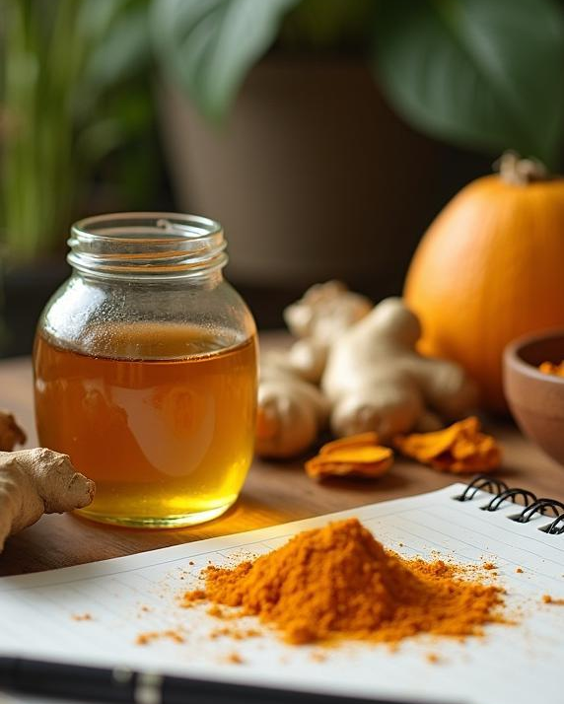
Objective and Goals
The main objective is to train a model that responds to user queries with home remedies using ingredients such as honey, ginger, and turmeric, avoiding suggestions for prescription medication. The aim is to provide a health-aware assistant capable of delivering safe and effective household-based advice.

Slide 5
Dataset Structure
The project automates the creation of a structured dataset using the Google Gemini API. This dataset includes an instruction, a user input detailing a symptom or illness, and an output recommending a remedy with appropriate disclaimers. The data is saved in JSON Lines format, ensuring diverse and relevant responses.

Slide 6
AI Functionality
The AI assistant is designed to provide cautious, home-based remedy suggestions for various common illnesses. By utilizing LLMs, it generates responses that offer natural and safe alternatives, encouraging users to try household ingredients instead of seeking prescription medications. This functionality is essential for ensuring health awareness and promoting safer home remedy practices.

Slide 7
02
Implementation Steps

Slide 8
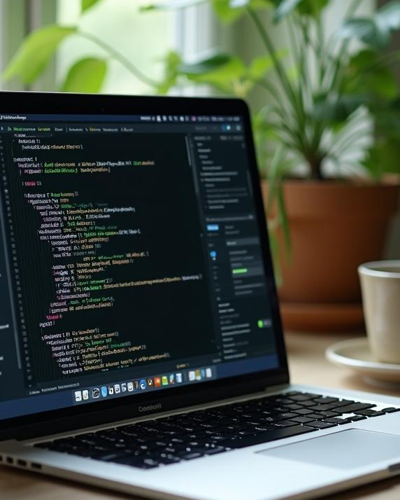
Unsloth Setup
The implementation begins with setting up the Unsloth library, which is responsible for optimizing the loading and fine-tuning of large language models. This process involves installing the Unsloth library from GitHub and preparing the Colab environment for efficient model training, enhancing both speed and memory usability.

Slide 9
Data Generation Process
To create a structured dataset, the Google Gemini API is employed for automatically generating training data. It generates a list of common illnesses and pairs each with multiple unique home remedy suggestions. This data is saved in a JSON Lines format, ensuring varied and comprehensive remedy responses that cover common non-serious ailments.

Slide 10
Model Training and Inference
The model training involves configuring the SFTTrainer from Hugging Face TRL to fine-tune the LoRA adapters on the prepared dataset. The training employs efficient settings, including 8-bit AdamW optimizers, allowing the model to be trained on only a small fraction of the total parameters while maintaining high performance. Inference demonstrates how the model generates remedy suggestions based on user inputs.

Slide 11
UI/UX
Gradio library allows to creates a simple, interactive web application. This UI loads the fine-tuned model (from the Hugging Face Hub repository), allows a user to type in an illness, and then streams the generated home remedy suggestion back to the user in real-time within the web interface.

Slide 12
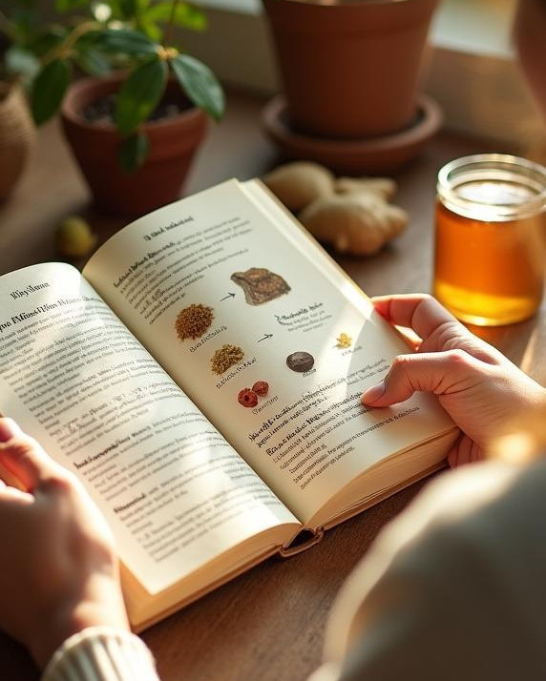
Conclusions
The fine-tuned AI assistant aims to provide safe and effective home remedies for common ailments using a specialized methodology. By harnessing the capabilities of LLMs through the Unsloth framework, the project showcases a viable approach to ensuring health-conscious interactions while educating users on natural alternatives.

Slide 13
THANK YOU!!

